Slide 1
MISSION BRIEFING · DAA COURSE REVIEW
DRONE DELIVERY
PATH PLANNER
Battery-Aware Routing with Dijkstra, TSP and Priority Queue
D
B
C
Every watt counts. Every route is justified.
Team: [names] · Guide: [name]
Notes:
This project plans drone deliveries under distance, battery and priority limits. Any route that exceeds the battery budget is rejected, and every decision is shown to the user. [Image: drone silhouette over a night city grid]

Slide 2
THE MISSION: PROBLEM & WHY IT MATTERS
DISTANCE
BATTERY
PRIORITY
Shortest legs between stops
Budget = 100 units, hard limit
Urgent drops served first
WHERE IT MATTERS
1
Medical supplies
2
E-commerce
3
Disaster relief
Urgent, time-critical
Many drops, low cost
Unreliable roads
Plan fast, explain every choice, reject unsafe routes.
2
BATTERY
83%
Notes:
One drone, one depot, several deliveries, three constraints. Over-budget routes are rejected rather than flown. Real uses include medical supplies, e-commerce and disaster relief. [Image: city map with depot hexagon and 5 drop points]

Slide 3
ARCHITECTURE & DATA MODEL
React +
Leaflet
Flask
API
Algorithm
Engine
JSON
result
Dijkstra · TSP · Priority Queue
ADJACENCY LIST (dist, energy)
DELIVERY RECORD
D: A(10), B(25)
A: D(10), B(8), C(20)
B: D(25), A(8), C(7)
C: A(20), B(7)
{ id: 3,
location: "C",
priority: 1,
weight: 2.5 }
3
BATTERY
67%
Notes:
The React and Leaflet front end calls a Flask API, which runs the algorithm engine and returns a JSON result the map draws. The data model is a weighted graph: edges carry distance and energy cost. Our worked example uses a depot plus delivery points and a 100-unit budget. [Icons: browser, server, gears]

Slide 4
PRIORITY QUEUE & DIJKSTRA
PRIORITY QUEUE (min-heap)
DIJKSTRA O((V+E) log V)
P1
dist[D]=0; push (0,D)
while pq: u=pop min
for (v,w) in adj[u]:
if dist[u]+w < dist[v]:
dist[v]=dist[u]+w; push
P2
P3
Tentative costs from D:
A=10 B=25→18 (via A) C=25 (via B)
Path: D → A → B → C
Rule: priority first, then lowest cost
push / pop: O(log n) peek: O(1)
heapq.heappush(pq,(prio,cost,id))
prio,cost,id = heapq.heappop(pq)
Why w ≥ 0? A negative edge could undercut a settled node.
4
BATTERY
50%
Notes:
The min-heap picks the most urgent delivery first, breaking ties by lowest cost, in O(log n) per operation. Dijkstra repeatedly settles the cheapest unsettled node and relaxes its edges. It needs non-negative weights, because a negative edge could lower an already-settled cost. Total time is O((V+E) log V). [Image: heap tree]

Slide 5
TSP: VISIT ORDER & RETURN TO DEPOT
Start at depot · visit each point once · return to depot
Method | Time | Optimal? | Best use
Brute force | O(n!) | Yes | n ≤ 8, baseline
Nearest neighbour | O(n²) | No | Fast estimate
Held-Karp DP | O(n²·2ⁿ) | Yes | n ≤ ~20, exact
Chosen for the demo: Held-Karp for exact order, nearest neighbour as the fast fallback.
5
BATTERY
33%
Notes:
TSP finds the visit order that starts and ends at the depot and visits each point once. Brute force is exact but factorial, nearest neighbour is fast but not optimal, and Held-Karp is exact and practical for small n. For a handful of drop points we can afford Held-Karp. [Image: route loop with hexagon nodes]

Slide 6
BATTERY CONSTRAINT & ROUTE REJECTION
ROUTE A
82% ACCEPTED
ROUTE B
127% REJECTED
100% budget
REASON SHOWN TO USER
Route B rejected: needs 127 units, budget is 100 (27 over). Drop a low-priority stop or split the trip.
6
BATTERY
17%
Notes:
This is the key idea: after choosing a route we check its energy against the 100-unit budget. Route A uses 82 percent and is accepted. Route B needs 127 percent, so it is rejected and the user sees exactly why. [Image: battery icon with check and cross]

Slide 7
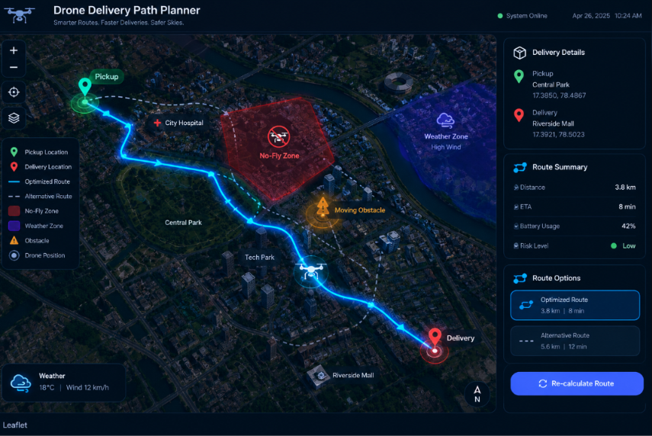
DEMO, RESULTS & MISSION COMPLETE
[Screenshot: Leaflet map with glowing route]
Visit order: D→A→B→C→D
Battery used: 82%
Status: ACCEPTED
Alert: Route B rejected (127%)
Cost saved: [__]%
Rejected: [__]%
Runtime: [__] ms
Limits: wind · payload weight · charging stops
Next: multi-drone fleets · no-fly zones · A* · real-time rerouting
MISSION COMPLETE · Q&A
7
BATTERY
0%
Notes:
The prototype shows the glowing route on a Leaflet map with a panel for visit order, distance, battery used and rejection alerts. Replace the placeholders with screenshots and measured numbers from your runs. Limitations are wind, payload weight and charging stops, and future work includes multi-drone fleets, no-fly zones, A* and live rerouting. Close with Q and A.

